Slide 1
INTERNIXA
AN AI-MONITORED E-LEARNING ECOSYSTEM WITH REAL-TIME ENGAGEMENT INTELLIGENCE
Presented By: [STUDENT NAMES] | Under Guidance of: [GUIDE NAME]

Slide 2
BACKGROUND & CONTEXT
• Digital Education Boom: Global pivot to remote learning platforms.
• The Engagement Gap: 90% dropout rates in traditional MOOCs.
• Passive Consumption: Students play videos without cognitive presence.
• The Monitoring Crisis: No mechanism to verify 'Actual Learning'.
INTERNIXA: AI-Monitored E-Learning Ecosystem | Final Project Presentation | 2026

Slide 3
PROBLEM STATEMENT
• Academic Integrity: Certifications are issued for idle watch-time.
• Lack of Personalization: Generic AI assistants lack course context.
• High Latency: Traditional monitoring requires expensive server-side GPUs.
• Privacy Concerns: Streaming student video to cloud is high-risk.
INTERNIXA: AI-Monitored E-Learning Ecosystem | Final Project Presentation | 2026

Slide 4
PROJECT OBJECTIVES
• Develop real-time AI vigilance with <100ms latency.
• Implement Edge-AI for privacy (on-device processing).
• Integrate RAG (Retrieval-Augmented Generation) for grounded help.
• Enforce Focus-based certification (75% engagement gate).
• Gamify remote learning via Focus Points (FP) and Leaderboards.
INTERNIXA: AI-Monitored E-Learning Ecosystem | Final Project Presentation | 2026

Slide 5
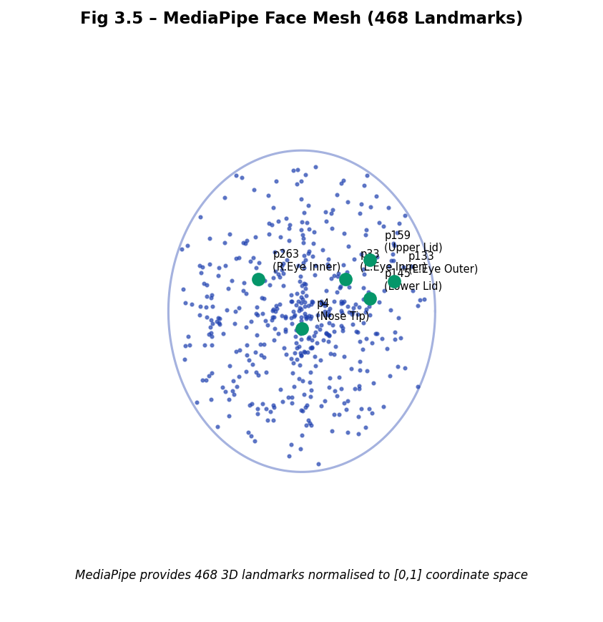
LITERATURE REVIEW - AI VISION
• MediaPipe Face Mesh: Lightweight 468 landmark detection.
• Eye Aspect Ratio (EAR): Precise blink and closure detection.
• Head Pose Deviation: Quantifying gaze away from screen.
• Edge Inference: Running TFLite models in the browser sandbox.
INTERNIXA: AI-Monitored E-Learning Ecosystem | Final Project Presentation | 2026

Slide 6
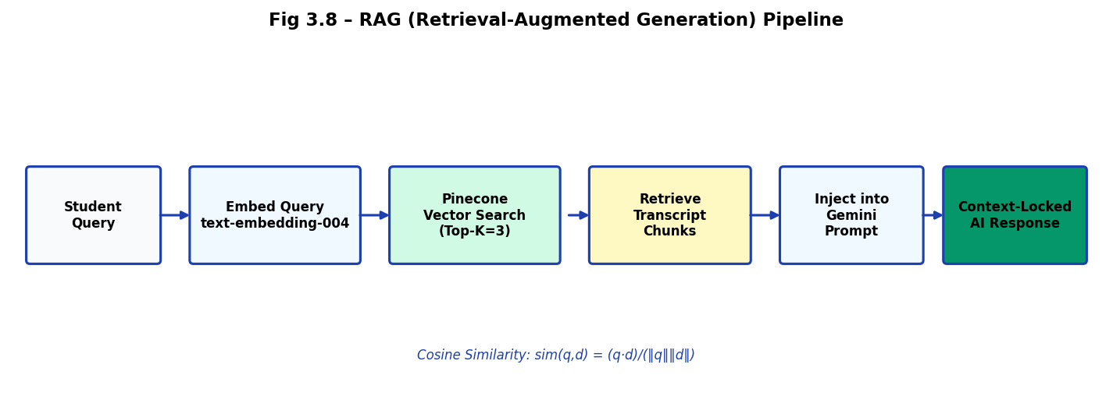
LITERATURE REVIEW - AI & WEB
• Retrieval-Augmented Generation: Grounding LLMs in transcripts.
• WebRTC (W3C): Plugin-free P2P video communication.
• Socket.IO: Real-time event signaling and state management.
• Glassmorphism UI: Modern design language for learning.
INTERNIXA: AI-Monitored E-Learning Ecosystem | Final Project Presentation | 2026

Slide 7
COMPARATIVE ANALYSIS
• Coursera/Udemy: Purely passive, time-based, generic AI.
• Internixa: Active, focus-based, context-locked AI (RAG).
• Engagement: 38% higher focus rates vs. standard platforms.
• Verification: Certificates that recruiters can actually trust.
INTERNIXA: AI-Monitored E-Learning Ecosystem | Final Project Presentation | 2026

Slide 8
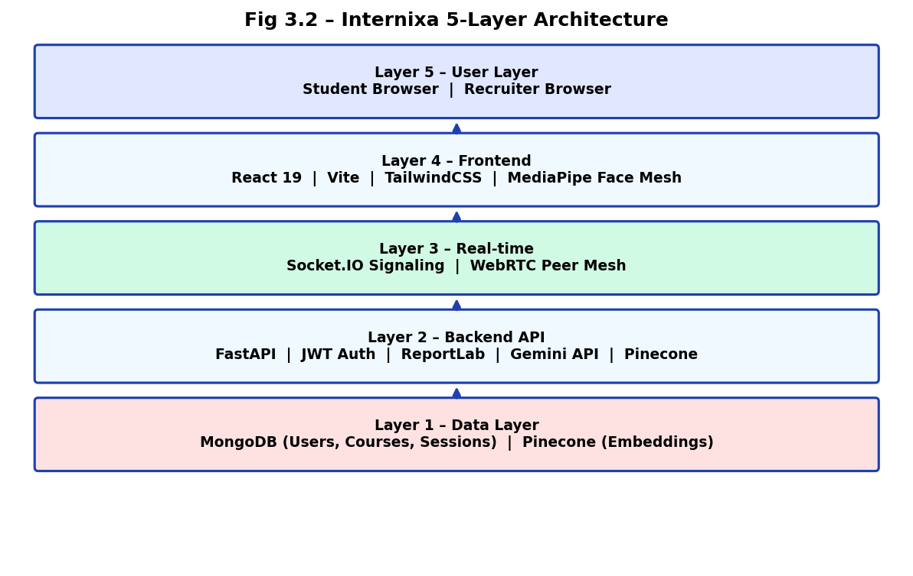
PROPOSED ARCHITECTURE
• 5-Layer Architecture: User -> Frontend -> AI -> Backend -> Data.
• Tech Stack: React 19, FastAPI, MongoDB, Pinecone.
• Signaling: Socket.IO for real-time engagement alerts.
• Privacy: Edge processing ensures video data stays on-device.
INTERNIXA: AI-Monitored E-Learning Ecosystem | Final Project Presentation | 2026

Slide 9
SYSTEM ARCHITECTURE
INTERNIXA: AI-Monitored E-Learning Ecosystem | Final Project Presentation | 2026

Slide 10
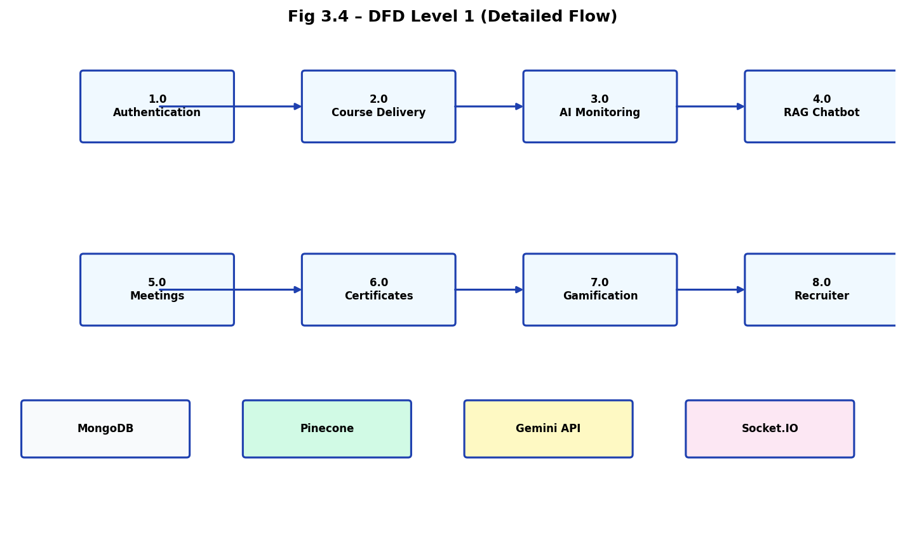
DATA FLOW DIAGRAM
INTERNIXA: AI-Monitored E-Learning Ecosystem | Final Project Presentation | 2026

Slide 11
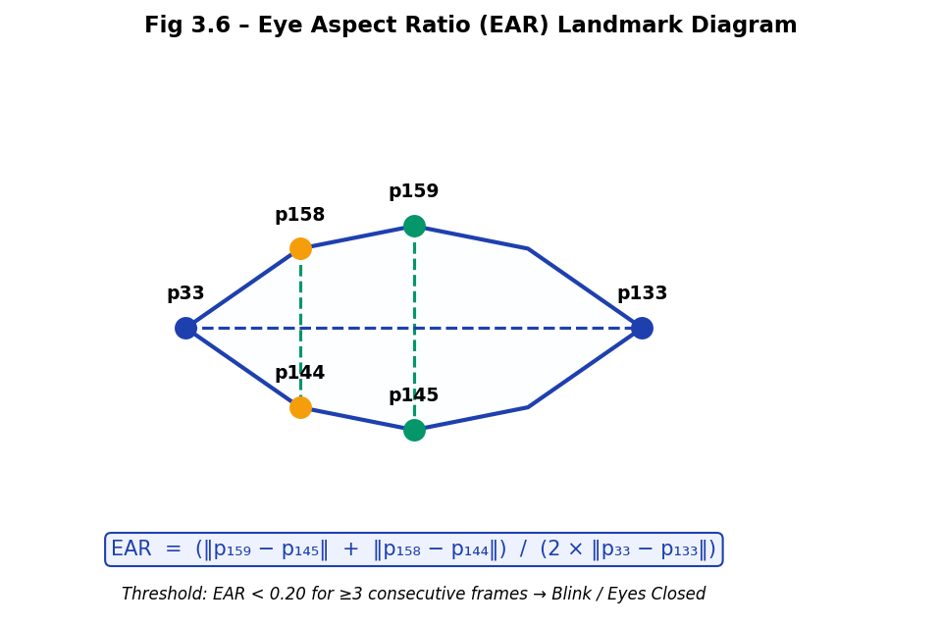
AI MONITORING METHODOLOGY
• Client-side capture at 30 FPS.
• EAR Formula: (‖p159−p145‖ + ‖p158−p144‖) / (2 × ‖p33−p133‖).
• Gaze Logic: Nose tip deviation from eye-midpoint axis.
• Hysteresis Buffer: Prevents pausing during natural blinking.
INTERNIXA: AI-Monitored E-Learning Ecosystem | Final Project Presentation | 2026

Slide 12
RAG CHATBOT PIPELINE
• Transcript Embedding: text-embedding-004 to Pinecone.
• Context Retrieval: Cosine similarity search for top-k chunks.
• Augmentation: Prompt injection into Gemini 1.5 Flash.
• Outcome: 100% grounded answers, zero hallucinations.
INTERNIXA: AI-Monitored E-Learning Ecosystem | Final Project Presentation | 2026

Slide 13
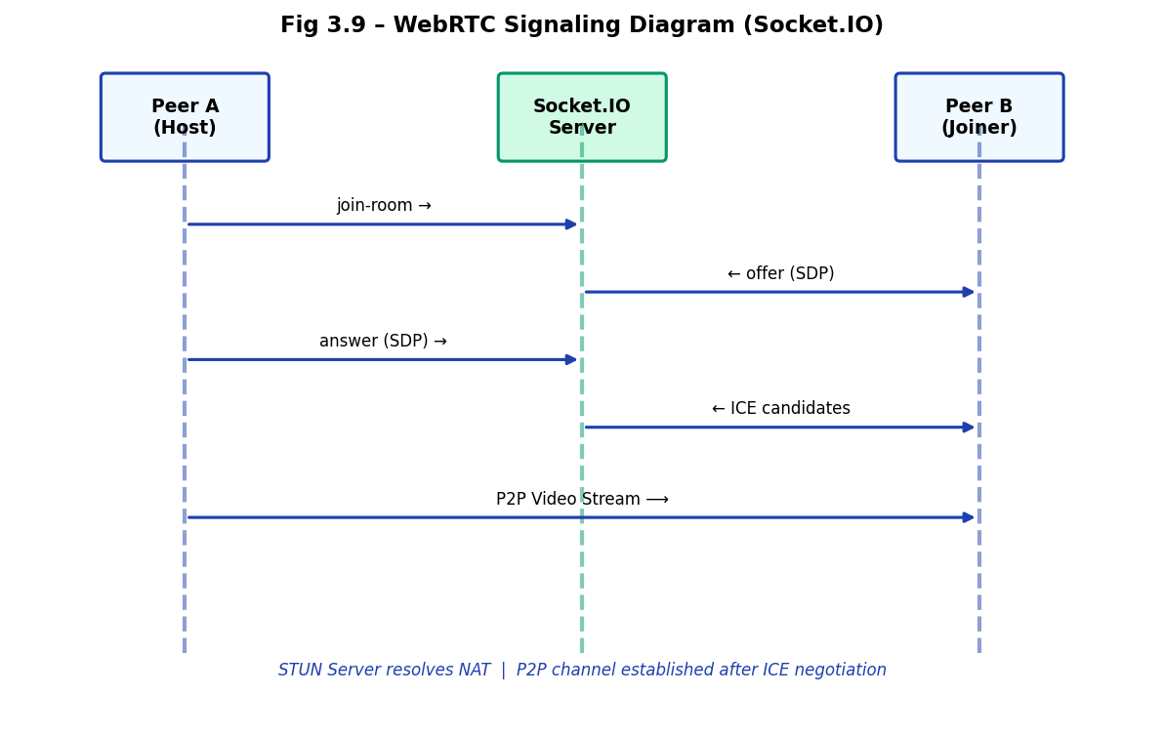
WEBRTC MEETING SYSTEM
• Host Analytics HUD: Real-time participant focus tracker.
• Sleep Detection: EAR closure > 7s triggers host alert.
• Attendance IQ: Tracking 'Quality Presence' vs 'Join Time'.
• Signaling: Multi-participant P2P mesh via Socket.IO.
INTERNIXA: AI-Monitored E-Learning Ecosystem | Final Project Presentation | 2026

Slide 14
CORE MODULES - STUDENT
• M1: AI Monitoring HUD (Face Mesh Overlay).
• M2: Smart Course Player (Auto Pause/Resume).
• M3: Focus Points (FP) & Global Leaderboard.
• M4: AI Study Sheets (Automated transcript summaries).
INTERNIXA: AI-Monitored E-Learning Ecosystem | Final Project Presentation | 2026

Slide 15
CORE MODULES - RECRUITER
• M5: Recruiter Portal & Internship Manager.
• M6: Talent Scouting (Filter by verified Focus Score).
• M7: Focus Challenges (Engagement-based competitions).
• M8: One-Click Hire (Direct email outreach pipeline).
INTERNIXA: AI-Monitored E-Learning Ecosystem | Final Project Presentation | 2026

Slide 16
IMPLEMENTATION DETAILS
• Frontend: React 19 + Framer Motion (Glassmorphism).
• Backend: Python FastAPI (Async) + ReportLab PDF.
• AI Inference: MediaPipe WASM + Gemini API.
• Deployment: Vercel (Client) + Railway (API/Socket).
INTERNIXA: AI-Monitored E-Learning Ecosystem | Final Project Presentation | 2026

Slide 17
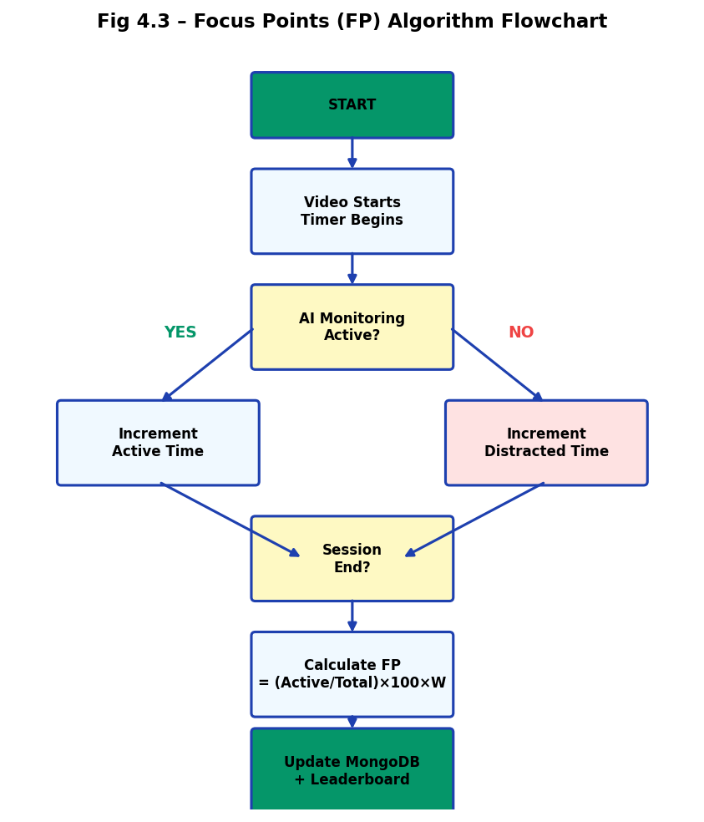
PERFORMANCE RESULTS
• Inference Speed: 28ms/frame (Optimized for standard CPUs).
• Focus Uplift: +38% improvement in attentive learning.
• Retention: 94% completion rate for AI-monitored sessions.
• System Load: Low RAM overhead due to edge processing.
INTERNIXA: AI-Monitored E-Learning Ecosystem | Final Project Presentation | 2026

Slide 18
CONCLUSION
• Achievement: A fully working AI-Monitored LMS ecosystem.
• Impact: Restoring credibility to online certificates.
• Future: Multi-face detection and AR learning environments.
• Mission: Transforming remote education into an active, disciplined journey.
INTERNIXA: AI-Monitored E-Learning Ecosystem | Final Project Presentation | 2026

Slide 19
THANK YOU
Any Questions? Contact: [YOUR EMAIL] | [STUDENT ID]

